Slide 1
CHATBOT
PRANITHA KEERTHI
TWISHA PUROHIT
SAIVENKAT THATIKONDA

Slide 2
INTRODUCTION
Chatbots are “computer programs which conduct conversation through auditory or textual methods”. Apple’s Siri, Microsoft’s Cortana, Google Assistant, and Amazon’s Alexa are four of the most popular conversational agents today. They can help you get directions, check the scores of sports games, call people in your address book, and can accidently make you order a $170 dollhouse.

Slide 3
MOTIVATION
Chatbots make life even easier for consumers. With chatbots, there’s no more long waits on hold to talk to a person on the phone or going through multiple steps to research and complete a purchase on websites.
Order Pizza
Product Suggestions
Customer Support
Weather
Search for & Track Flights

Slide 4
RELATED WORK
Watson Assistant - IBM
Amelia – Ipsoft
H&M Kik : The official H&M chatbot
Erika- Bank of America
Endurance : A Companion for Dementia Patients
Casper: Helping Insomniacs Get Through the Night

Slide 5
LITERATURE REVIEW
The Unreasonable Effectiveness of Recurrent Neural Networks
http://karpathy.github.io/2015/05/21/rnn-effectiveness/
-Andrej Karpathy
Fundamentals of Recurrent Neural Network (RNN) and Long Short-Term Memory (LSTM) Network
https://arxiv.org/abs/1808.03314
-Alex Sherstinsky

Slide 6
Why creating a chatbot is a NLP problem?
WHAT?
Natural language processing (NLP) is a branch of artificial intelligence that helps computers understand, interpret and manipulate human language. NLP draws from many disciplines, including computer science and computational linguistics, in its pursuit to fill the gap between human communication and computer understanding.
WHY?
Natural Language Processing is what allows chatbots to understand your messages and respond appropriately.

Slide 7
RECURRENT NEURAL NETWORKS
WHAT?
A recurrent neural network is a class of artificial neural network where connections between nodes form a directed graph along a temporal sequence.
WHY?
To answer properly in a chatbot it needs to remember the previous output, a Recurrent Neural Network is a deep learning model dedicated to the handling of sequences.

Slide 8


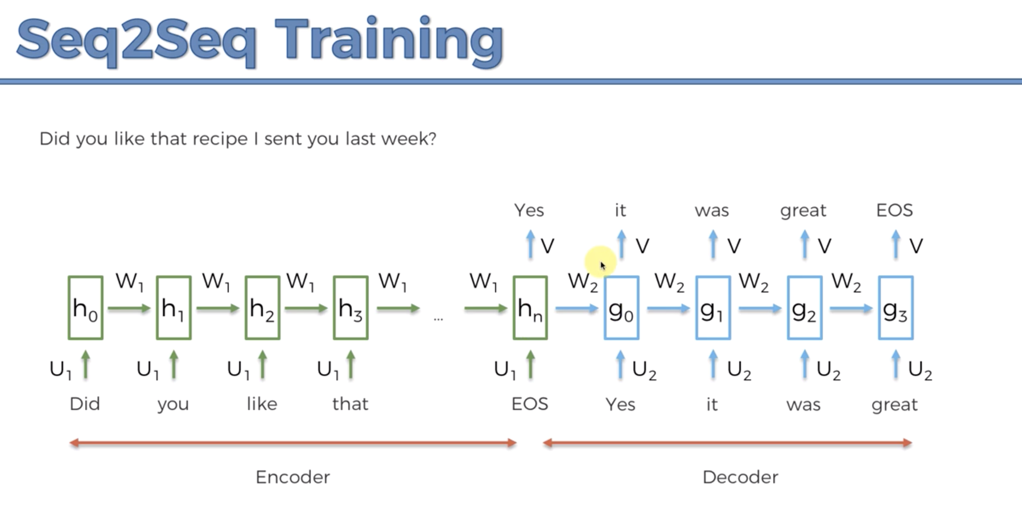

PROPOSED APPROACH
ALGORITHM: Sequence2Sequence model using LSTM Recurrent Neural Network Model

Slide 9
DATASET
Cornell Movie--Dialogs Corpus
This corpus contains a large metadata-rich collection of fictional conversations extracted from raw movie scripts:
- 220,579 conversational exchanges between 10,292 pairs of movie characters
- involves 9,035 characters from 617 movies
in total 304,713 utterances

Slide 10
LIBRARIES USED
Numpy Library
Tensor Flow
Regular Expression Library
Time Library

Slide 11
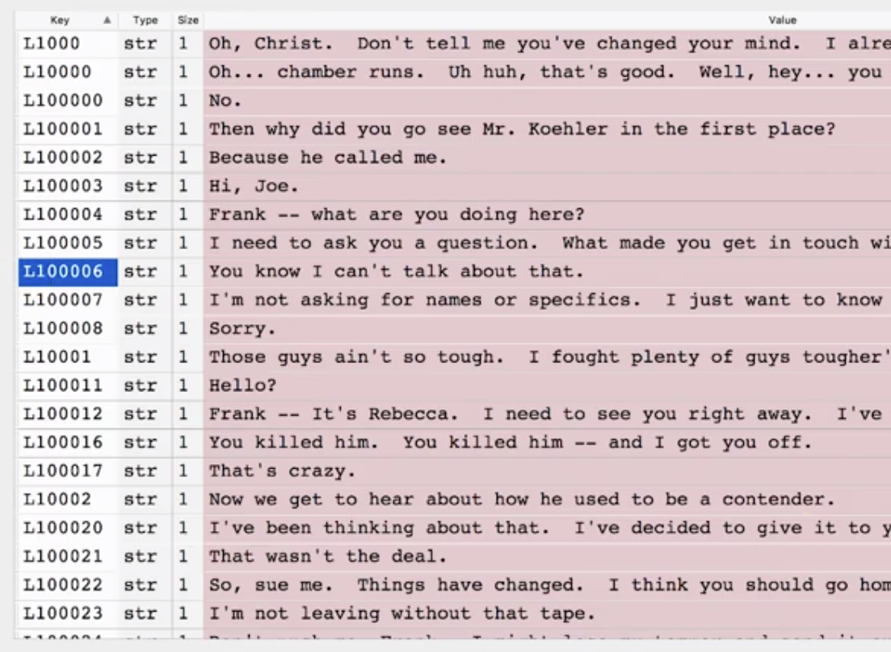
DATA PRE-PROCESSING
Load the dataset Cornell Movie--Dialogs Corpus (only conversation and lines file).
Creating a dictionary that maps each lines and it’s respective id’s.

Slide 12
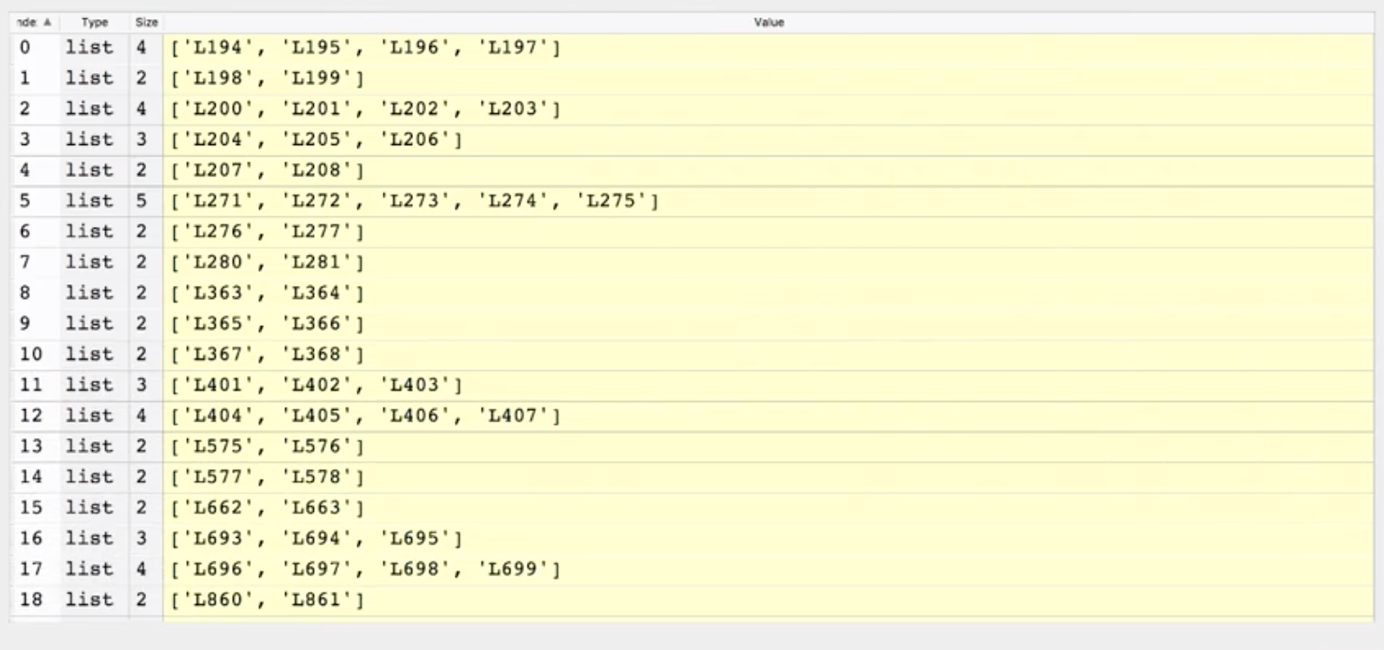
Creating a list of all of the conversations.

Slide 13
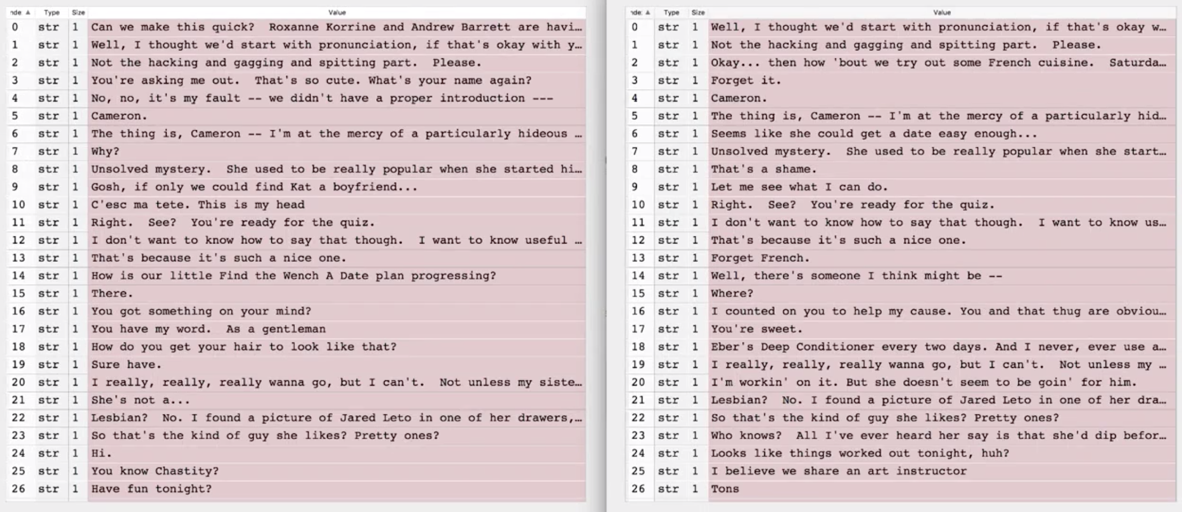
Getting separately the questions and the answers.

Slide 14
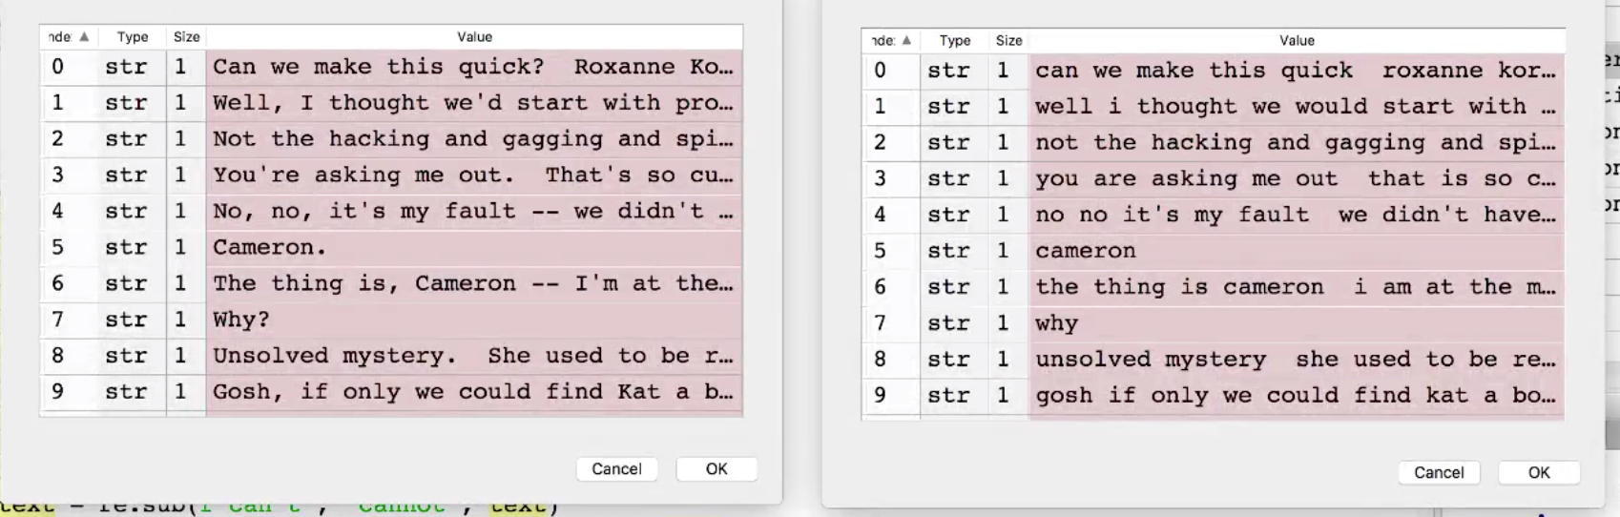
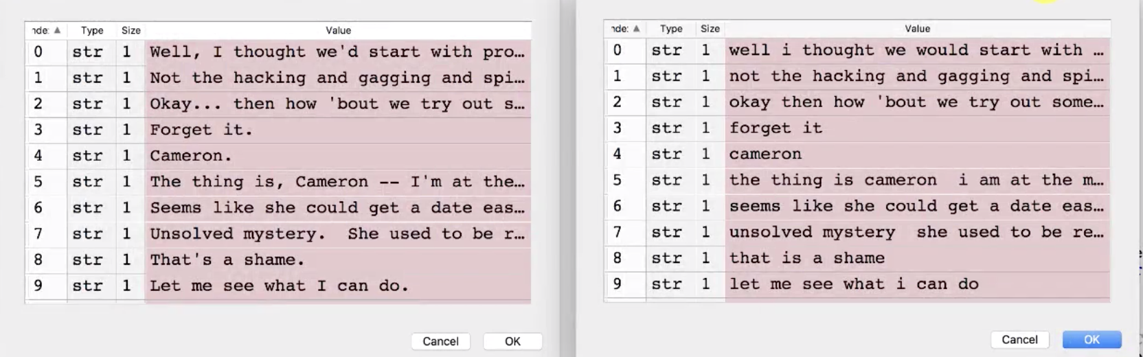
Doing a first cleaning of the texts(convert all the words in lower case, remove all the apostrophes)

Slide 15
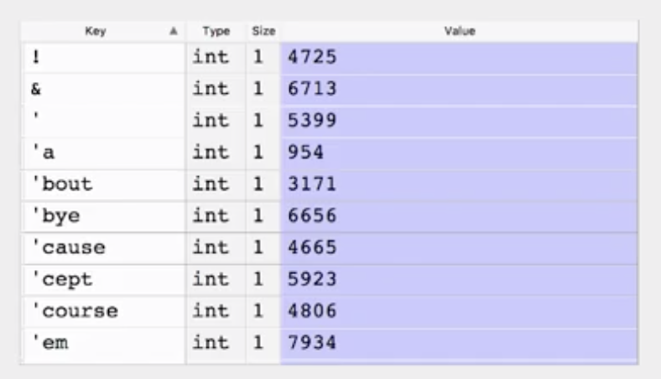
Creating a dictionary that maps each word to it’s number of occurrences.
Creating two dictionaries that map the questions words and the answer words to a unique integer.(Tokenization and filtering non-frequent words)
Adding the last tokens to the above two dictionaries. Tokens are,
PAD, EOS, OUT,SOS

Slide 16
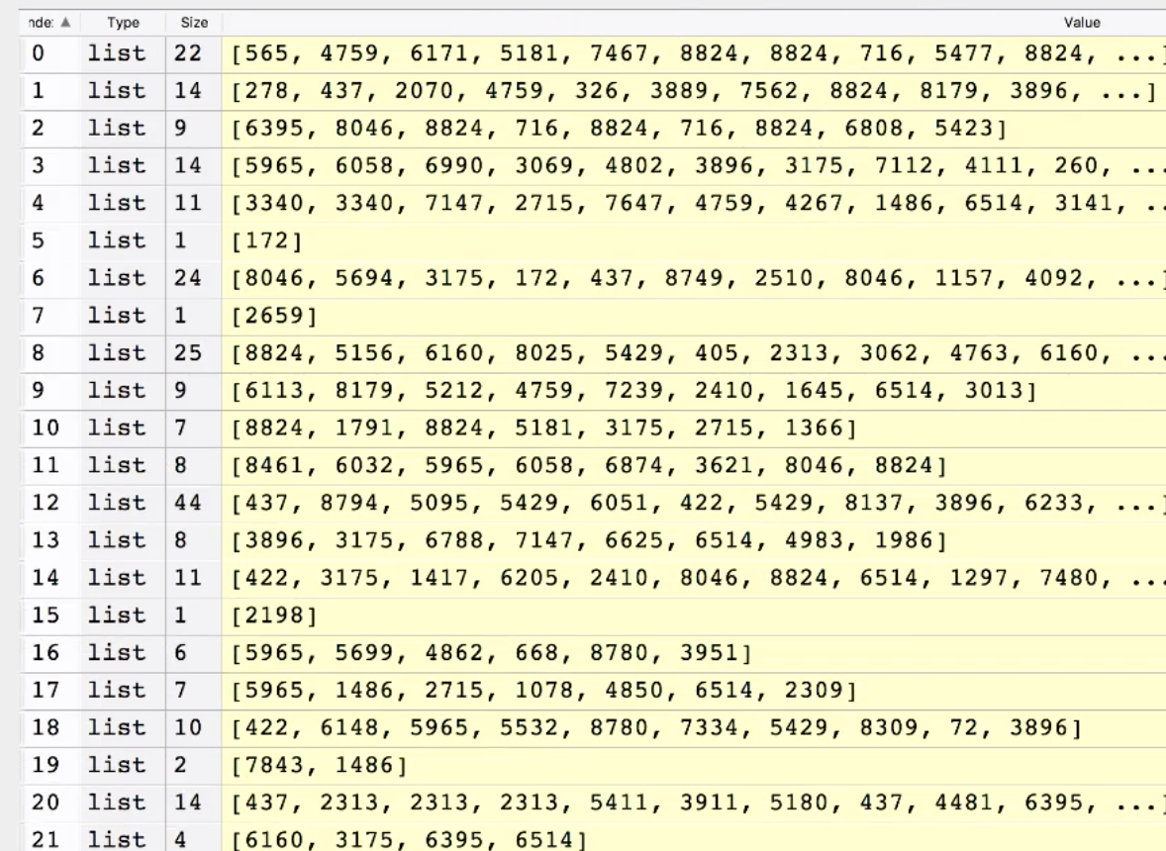
Translating all the questions and answers into integers and replacing all the words that were filtered out.

Slide 17
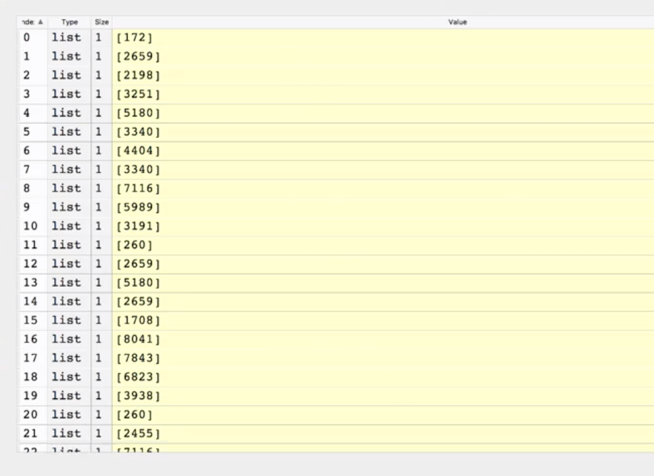
Sorting questions and answers by the length of questions.

Slide 18
IMPLEMENTATION

Slide 19
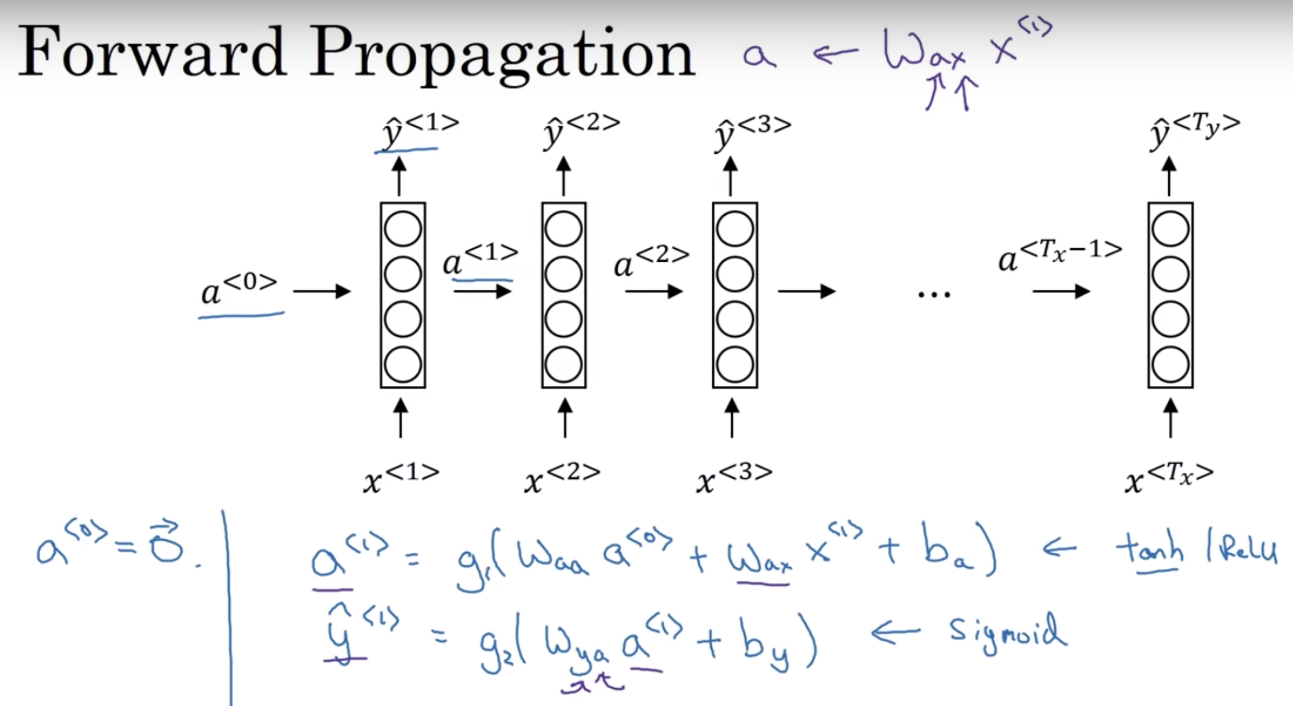

Slide 20
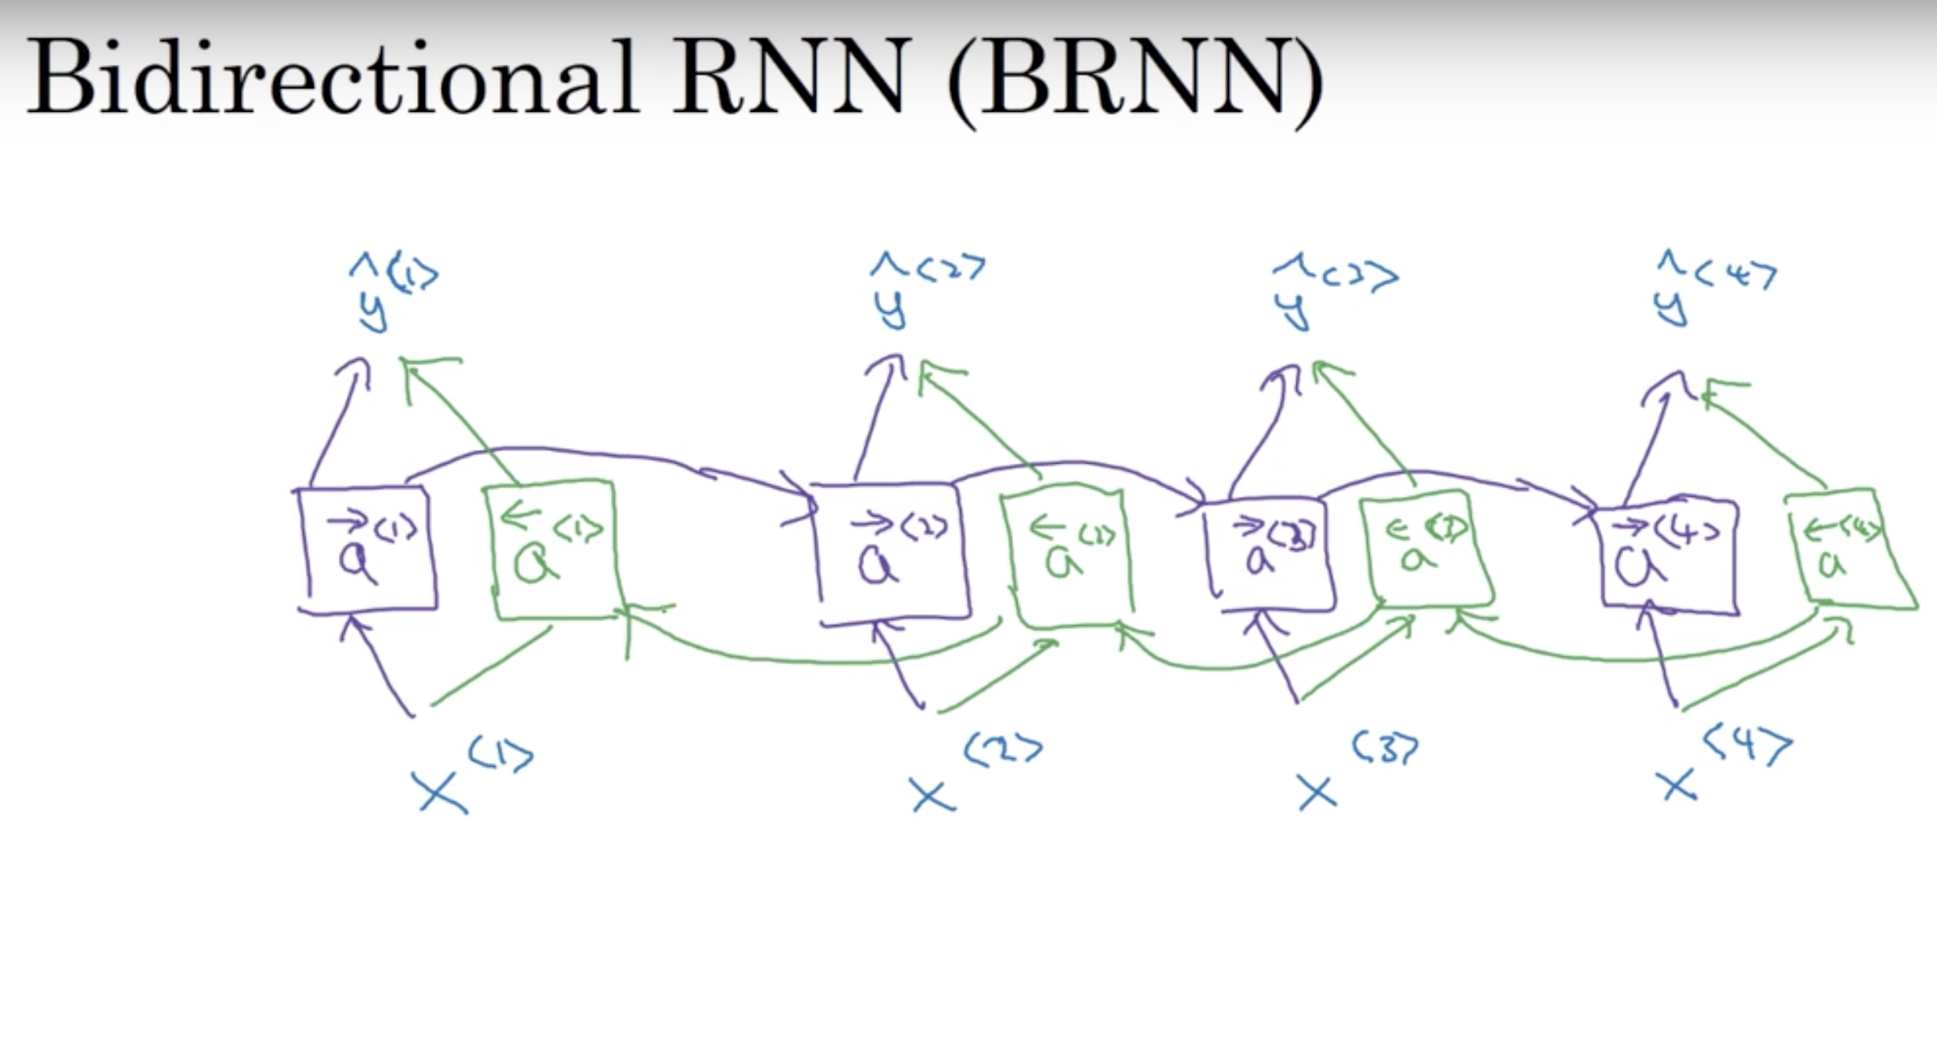

Slide 21
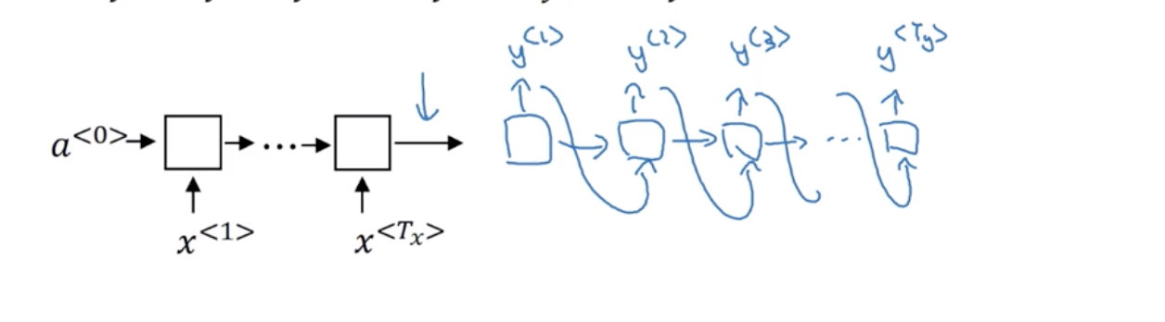
Sequential2Sequential Model

Slide 22
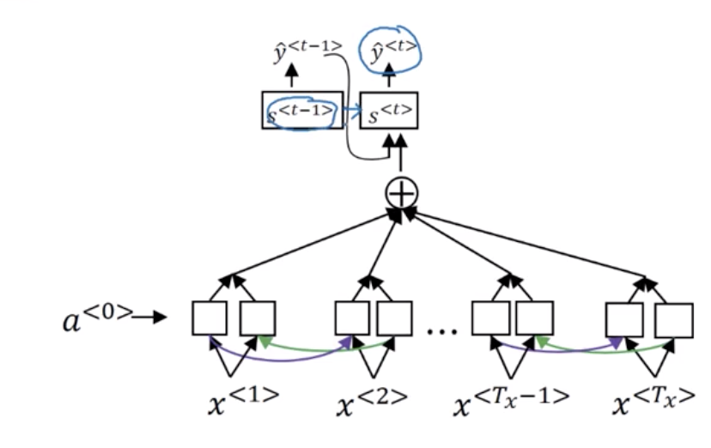
Attention Model

Slide 23
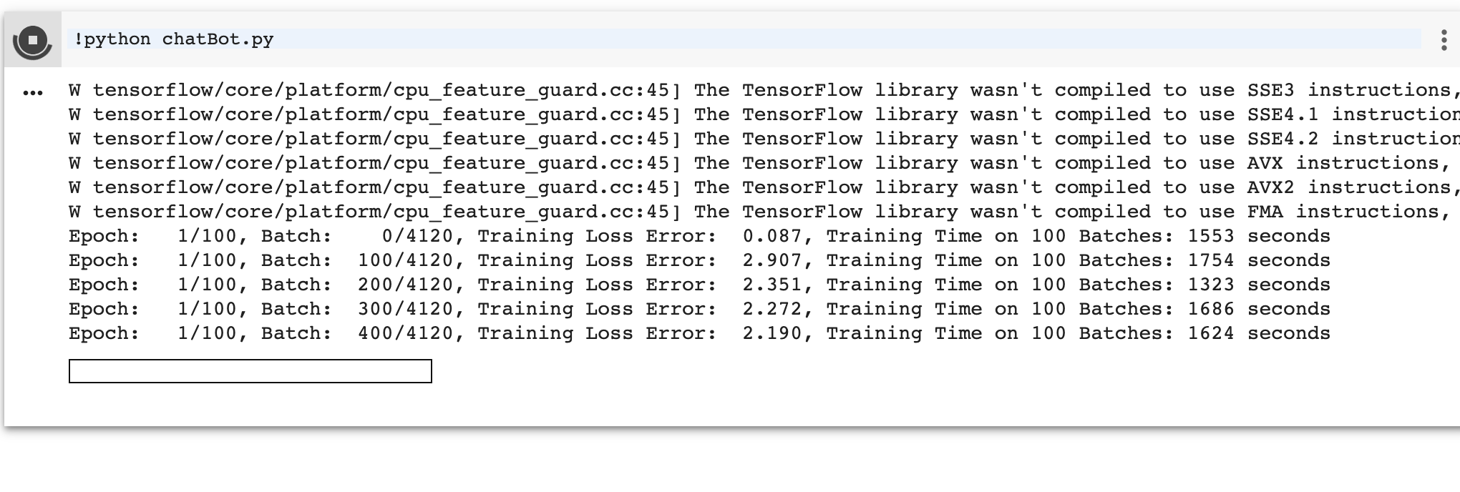
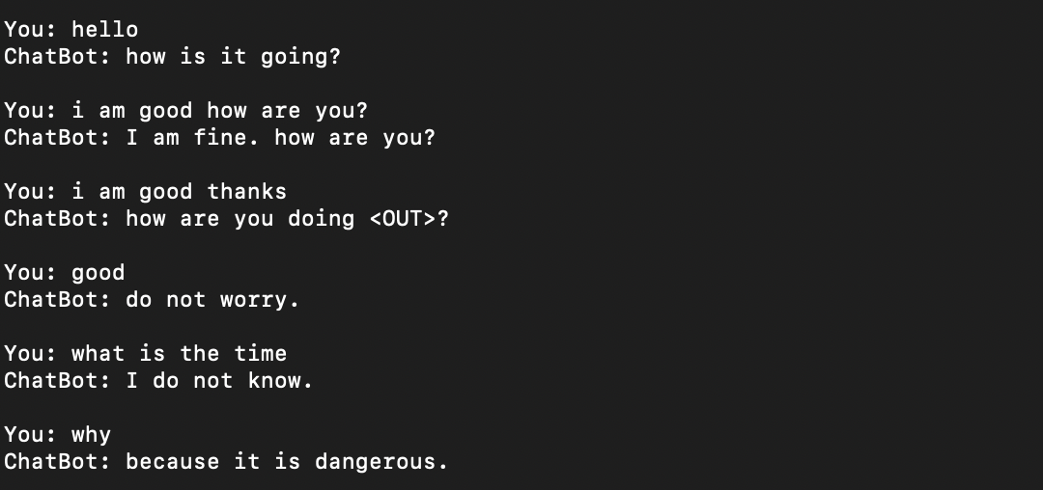
RESULTS

Slide 24
THANK YOU!

